Slide 1
Reading Signs with Convolutional Neural Networks
Owen Peng
Chris Park
Raphael Krantz
Notes:
We chose to do an image recognition project utilizing Convolutional Neural Networks. I’m going to introduce the project, Chris will walk us through some of the details of various models we designed, and Owen will conclude by walking us through how we can interpret our results. Let's get started.

Slide 2
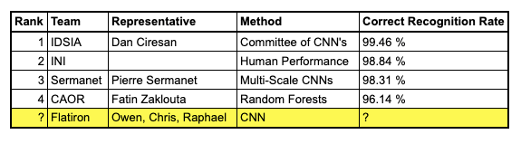
Project Introduction
Project originates from a competition held at the International Joint Conference on Neural Networks (IJCNN) in 2011
A classification problem for multi-class single-images of German Traffic signs
How would we compare to competition finalists?
Notes:
We found our data on Kaggle. The data comes from a competition in 2011 sponsored by the International Joint Conference on Neural Networks. The challenge was to accurately classify individual images of German traffic signs utilizing multiple classes.Below you can see the finalists for the competition. It is interesting to note that not all finalists used CNN’s. There is one submission using random forest and one of the finalist recognition rate was from old-fashioned human performance. Now we’ll overview the data.

Slide 3
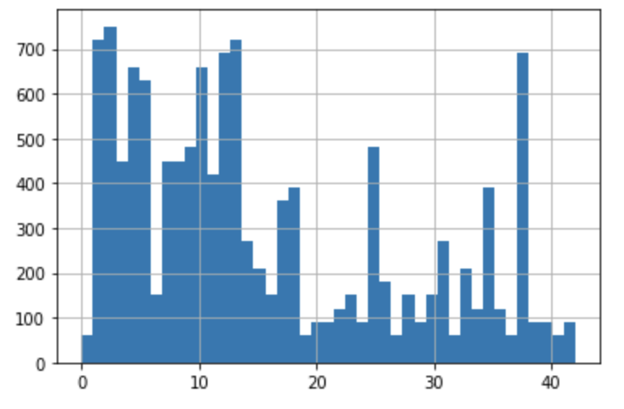

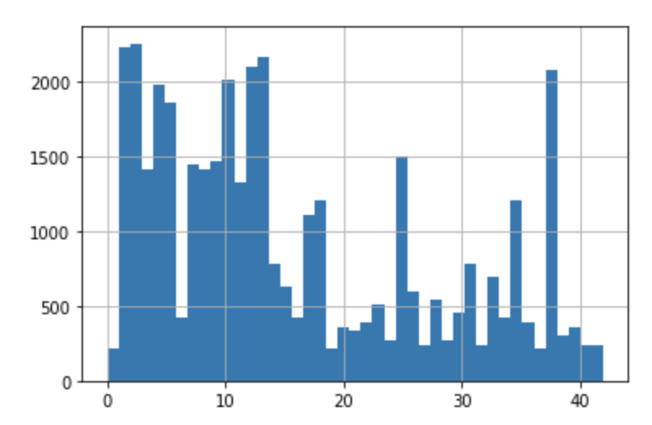

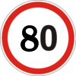

Overview of Data
Dataset - 51,839 Photos of German Traffic Signs
Source - 2011 Kaggle Competition
Training Dataset: 39209 Photos
Testing Dataset: 12630 Photos
Sign classes: 43
Notes:
Our data had over 50K individual images including almost 40k training images, and more than 10k test images.
On the right, you can see the distributions for test images at the top, and training images at the bottom. You can see that they have almost the same distribution among the 43 classes.
Finally, you can see an example of an image and possible sign classes our model had to choose from.

Slide 4
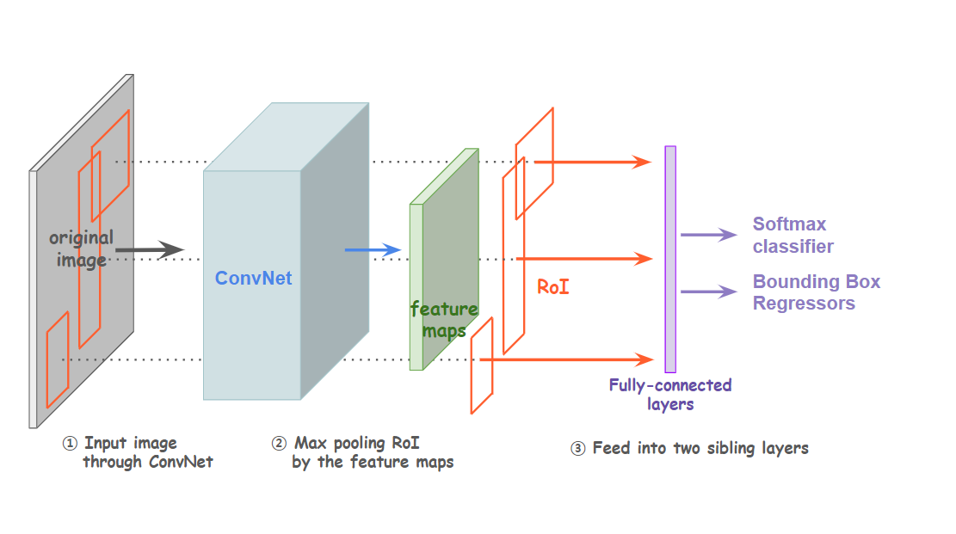
Convolutional Neural Network Architecture
Input Layer - Convolutional (64 Nodes)
Activation: RelU + Max Pooling
1st Layer - Convolutional (128 Nodes)
Activation: RelU + Max Pooling
2nd Layer - Convolutional (128 Nodes)
Activation: RelU + Max Pooling
3rd Layer - Dense (64 Nodes)
Activation: RelU + Max Pooling
4th Layer (Output) - Dense (43 Nodes)
Activation: Softmax
Parameters
Kernel Size: 3x3
Pooling Window Size: 2x2
Optimizers - Adam/ RMSprop
Notes:
Here is an overview of our network design. We utilized a network with 3 hidden layers in addition to the input and output layers.
We used Relu activation and maxpooling for our dimension reduction. We primarily used Adam and RMSprop as our optimizers when we compiled the models. Chris will now take us through those details.

Slide 5
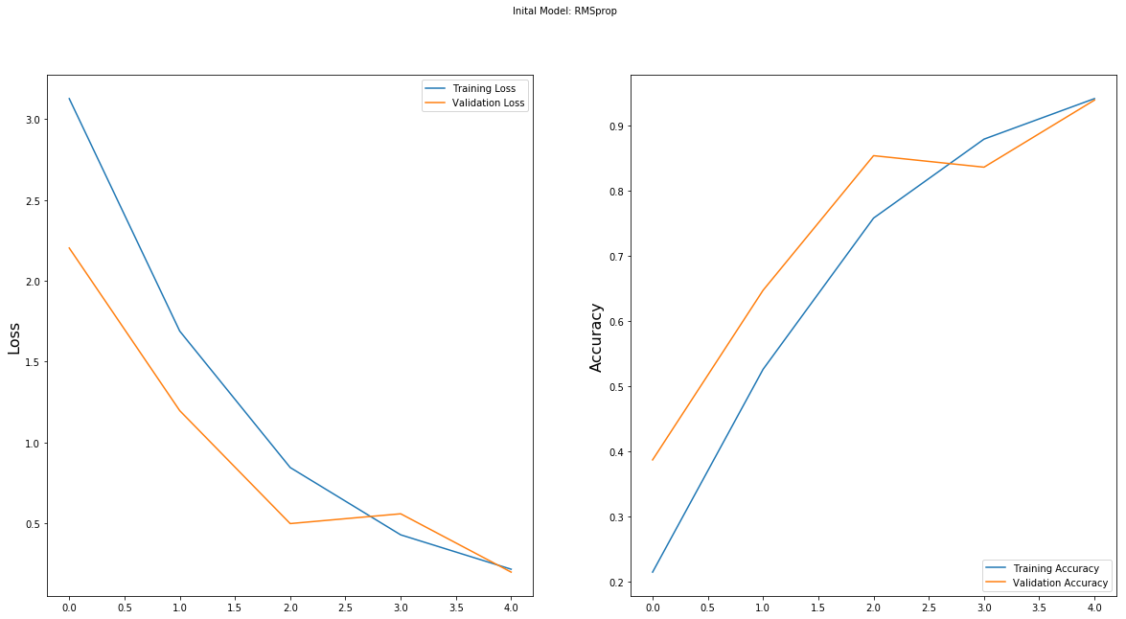
Initial Model: 4 Layer ConvNet - RMSprop
# of Epochs = 5
Batch size = 750
Accuracy = 0.941
Validation Accuracy = 0.939
Loss = 0.218
Validation Loss = 0.200
Test Accuracy = 0.902
F1 score = 0.905
Notes:
I will be going over the results for our models that we ran. This is our initial model with an epoch size of 5 and a batch size of 750 using an RMSprop optimizer..
The left plot over here depicts our loss over epoch size and the right plot depicts our accuracy over epoch size. The blue line for both plots represents our training dataset and yellow represents our validation. Ideally we would like to see our curves leveling off into maturity however as you can clearly see they are not quite there rendering a bit of variability using 5 epochs. So we attempted to correct it by increasing our epch size.

Slide 6
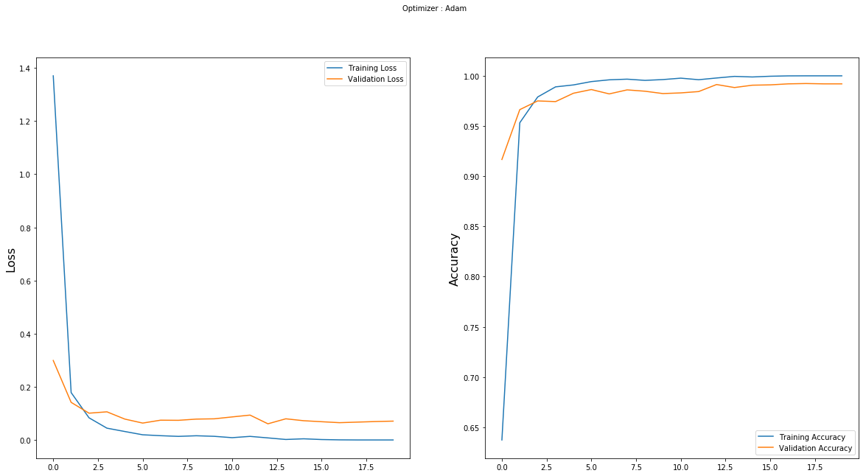
4 Layer ConvNet - Adam
# of Epochs = 20
Batch size = 250
Accuracy = 1.000
Validation Accuracy = 0.992
Loss = 0.0000276
Validation Loss = 0.0709
Test Accuracy = 0.945
F1 score = 0.946
Notes:
So we increased our epoch size, reduced our batch size, and increased the number of nodes for our layers to capture higher dimensional feature which tremendously improved our loss and accuracy. Our curves are leveling off indicating that our model has learned well. This bumped our testing accuracy to 94.5

Slide 7
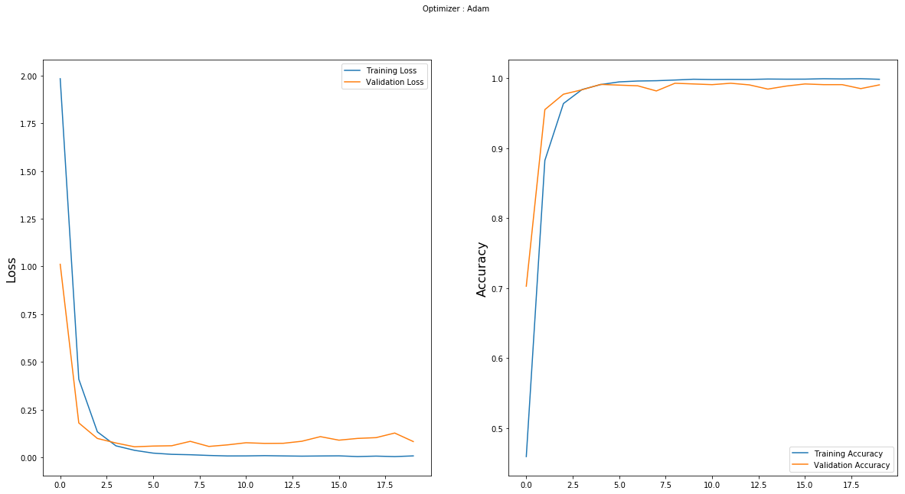
4 Layer ConvNet - RMS PROP
# of Epochs = 20
Batch size = 250
Accuracy = 0.998
Validation Accuracy = 0.990
Loss = 0.0069
Validation Loss = 0.0821
Test Accuracy = 0.955
F1 Score = 0.956
Notes:
This was our best model which we obtained through using the same parameters as the model mentioned in our last slide. And we were able to reach a final test accuracy of 95.5%, which we were very pleased with. However this morning we ran a 6 layer model that outputed a test accuracy of 96%.
And finally Id also like to mention that we ran models with drop layers, l2 regularization, and padding but it did not incraese our overall accuracy so we chose to go with our respective parameters.

Slide 8
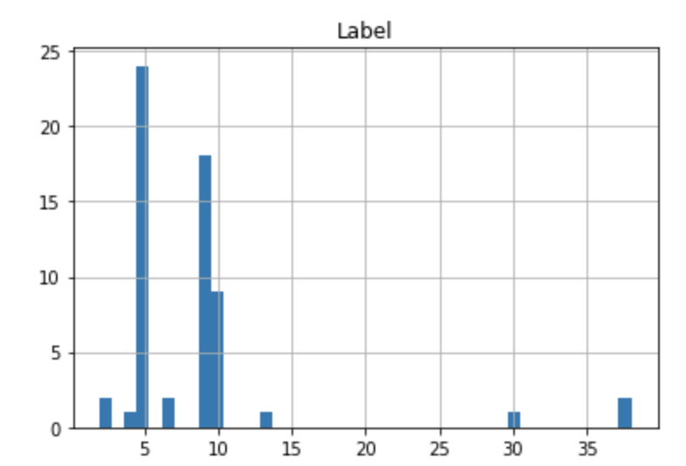
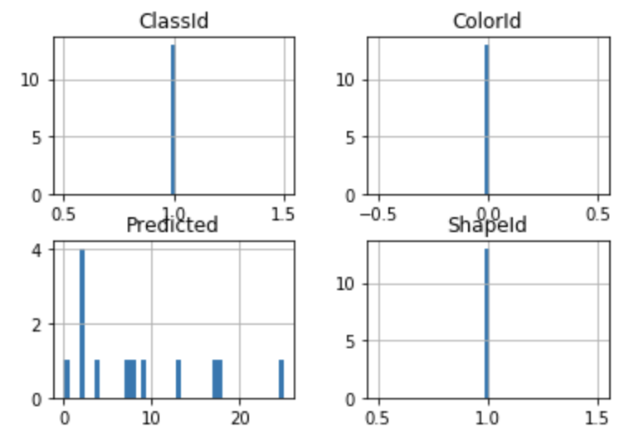

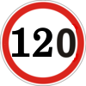

Misclassification Interpretation
Test Accuracy - 95.6% Accuracy
Our model made mistakes on similar symbols, but there were zero errors for classifying shape and color of signs
Our model was able to classify symbols with 95.6% accuracy and was able to classify the shape and the color of a sign with 100% accuracy
95.6% Accuracy
100% Accuracy
Notes:
I’m talking interpreting our misclassified predictions. I would say our model is pretty good, we were able to correctly classify 96% of our testing dataset properly. I wanted to look into the 4.4% of photos that were misclassified. Here I have a couple plots of the misclassified data. The ClassId represents the proper classification for the data points, and the predicted plot shows what the wrong guesses for the classification were for that sign. You can see that there were multiple possible wrong guesses for the one sign, but what was promising for the model was that the while the actual sign varied, the guesses were always of the same color and shape of the proper label. This means that while our model sometimes guessed the actual symbol on the sign wrong, it was able to guess the color and shape of the sign with 100% accuracy. Here is an example of a pair that our model might get wrong. These signs have the same color and the same shape, but vary only in their middle digit. This is a classification that our model would get right 95.6% of the time. This other pair is one of signs with the same shape, but different colors. This is a guess that the model would get correct 100% of the time.

Slide 9



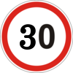




Most Commonly Misclassified
Mislabeled Sign Pairs by Error Frequency (Left to Right)
29/685
25/685
24/685
24/685
24/685
Notes:
Here I have the five most misclassified pairs of signs. These signs were most commonly mistaken for each other. As you can see these results align with our previous theory on the classification of the pictures. For all these pairs, the signs had the same color and the same shape, but differed in their symbols. These symbols, especially the numbers are very similar in symbol shape.

Slide 10
Conclusion
With a relatively simple neural network, we were able to correctly assign correctly classify German street signs with 96% accuracy
Our best combination of neural net parameters was a four layer convolutional neural net with an RMSprop Optimizer, Batch Size of 250, and ReLu Activation
The neural network had 100% accuracy when classifying the shape and color of a sign
Possible Applications:
Self Driving Cars
Kaggle Competitions
Notes:
In conclusion I would say that this project was a success. Though we only created a simple neural net with 4 layers. Many neural nets can be upwards of a hundred layers. Despite the simplicity, our model was able to achieve 96% accuracy for predicting street signs. Our best combination of parameters would use an RMSProp, Batch size of 250, Relu Activation. We were also very impressed that the model was able to predict the shape and color of a sign with 100% accuracy. There was also more data that we didn’t utilize in our neural net which could have potentially increased our accuracy further. We think this model could be used for self driving cars driving on the highway. A self driving car would need to be able to recognize signs and change driving behavior according to the street signs.

